Slide 1
Introduction to HTML

Slide 2
What the following term mean:
Web server: a system on the internet containing one or more web site
Web site: a collection of one or more web pages
Web page: single disk file with a single file name
Home page: first page in website

Slide 3
Think about the followings before working your Web pages
Think about the sort of information(content) you want to put on the Web.
Set the goals for the Web site.
Organize your content into main topics.
Come up with a general structure for pages and topics.

Slide 4
What is HTML ?
“HTML is the standard markup language for creating Web pages”
HTML stands for Hyper Text Markup Language
HTML describes the structure of Web pages using markup
HTML elements are the building blocks of HTML pages
HTML elements are represented by tags
Browsers do not display the HTML tags, but use them to render the content of the page

Slide 5
A Simple HTML Document
<html> <head> <title>Page Title</title> </head> <body> <h1>My First Heading</h1> <p>My first paragraph.</p> </body>
</html>

Slide 6
Example Explained
The <html> element is the root element of an HTML page
The <head> element contains meta information about the document
The <title> element specifies a title for the document
The <body> element contains the visible page content
The <h1> element defines a large heading
The <p> element defines a paragraph

Slide 7
HTML Tags
“HTML tags are element names surrounded by angle brackets”
<tagname>content goes here...</tagname>
HTML tags normally come in pairs like <p> and </p>
The first tag in a pair is the start tag, the second tag is the end tag
The end tag is written like the start tag, but with a forward slash inserted before the tag name

Slide 8
Web Browsers
The purpose of a web browser (Chrome, IE, Firefox, Safari) is to read HTML documents and display them
The browser does not display the HTML tags, but uses them to determine how to display the document

Slide 9
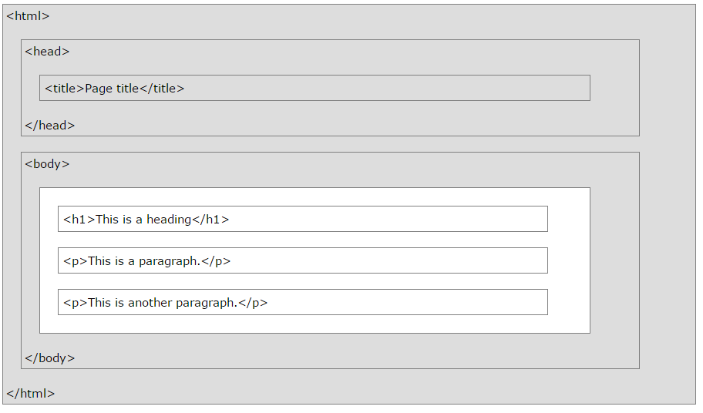
HTML page structure

Slide 10
HTML Editors
Step 1: Open VS code -> Take new folder-> Name a file as index.html
Step 2: Write HTML code
Step 3: Save the HTML Page
Step 4: View the HTML Page in Your Browser

Slide 11
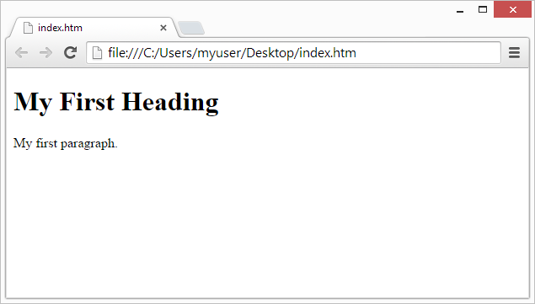
Web Browsers

Slide 12
HTML Headings
HTML headings are defined with the <h1> to <h6> tags
<h1> defines the most important heading
<h6> defines the least important heading

Slide 13
HTML Paragraphs
HTML paragraphs are defined with the <p> tag

Slide 14
HTML Images
HTML images are defined with the <img> tag
The source file (src), alternative text (alt), width, and height are provided as attributes

Slide 15
HTML Links
HTML links are defined with the <a> tag
The href attribute specifies the destination address (https://www.w3schools.com/html/) of the link.
The link text is the visible part
Clicking on the link text will send you to the specified address.

Slide 16
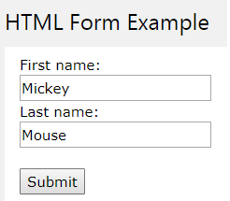
HTML forms
The HTML <form> element defines a form that is used to collect user input
<form> . form elements . </form>

Slide 17
The <input> Element
The <input> element is the most important form element.
The <input> element can be displayed in several ways, depending on the type attribute
Type | Description
<input type="text"> | Defines a one-line text input field
<input type="radio"> | Defines a radio button (for selecting one of many choices)
<input type="submit"> | Defines a submit button (for submitting the form)

Slide 18
Text Input
<input type="text"> defines a one-line input field for text input
Example
<form>
First name:<br> <input type="text" name="firstname"><br>
Last name:<br> <input type="text" name="lastname">
</form>

Slide 19
Text Input Example
This is how it will look like in a browser:
First name:
Last name:

Slide 20
Radio Button Input
<input type="radio"> defines a radio button.
Radio buttons let a user select ONE of a limited number of choices
Example
<form> <input type="radio" name="gender“ > Male<br> <input type="radio" name="gender“ > Female<br> <input type="radio" name="gender“ > Other
</form>

Slide 21
Radio Button Input Example
This is how the HTML code above will be displayed in a browser
Male
Female
Other

Slide 22
The Submit Button
<input type="submit"> defines a button for submitting the form data to a form-handler.
The form-handler is typically a server page with a script for processing input data.
The form-handler is specified in the form's action attribute

Slide 23
The Submit Button Example
<form action="student_page.php">
First name:<br> <input type="text" name="firstname"><br> Last name:<br> <input type="text" name="lastname"><br><br> <input type="submit" value="Submit">
</form>

Slide 24
The Submit Button Example
This is how the HTML code above will be displayed in a browser
First name:
Last name:
Submit

Slide 25
The Action Attribute
The action attribute defines the action to be performed when the form is submitted
Normally, the form data is sent to a web page on the server when the user clicks on the submit button
In the example above, the form data is sent to a page on the server called "student_page.php". This page contains a server-side script that handles the form data

